Slide 1
Module 3 (upto ISE)
Different Neural Networks

Slide 2
Syllabus
Different Neural Networks 10 CO2, CO3
3.1 Associative memory network – Basic Concepts, Types- Auto, Hetro, Bidirectional (Discrete and continuous), Testing
3.2 Hopfield – Discrete, continuous, Counter propagation network, ART, SOFM, Recurrent Network

Slide 3
Introduction
An associative memory network can store a set of patterns as memories.
When the associative memory is being presented with a key pattern, it responds by producing one of the stored patterns, which closely resembles or relates to the key pattern.
Thus, the recall is through association of the key pattern, with the help of information memorized.
These types of memories are also called as content-addressable memories (CAM) in contrast to that of traditional address-addressable memories in digital computers where stored pattern (in byres) is recalled by its address.

Slide 4
Types of Associative Memory
Auto-associative memory
Hetro-associative memory
Both these nets are single layer nets in which the weights are determined in a manner that the net stores a set of pattern associations.
If each of the output vectors is same as the input vectors with which it is associated, then the net is a said to be auto-associative memory On the other hand if the output vectors are different from the input vectors then the net is said to be hetro-associative memory net.

Slide 5
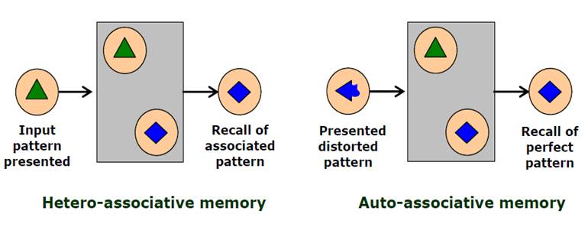
Example

Slide 6
Training algorithm for pattern association-Hebb Rule
Hebb rule
Used for finding the weights of an associative memory neural net.
Training vector pairs are denoted by s:t
Algorithm
Step 0: Initialize weights to 0
w_{ij}=0 (i= 1 to n, j=1 to M)
For each training target input output vectors s:t,
Activate the input layers for training input.
x_{i}=s_{i}(for i=1 to n)
Activate the output layers for target output.
y_{i}=t_{i} (for j=1 to m)
Start weight adjustment.
w_{ij}(new)=w_{ij}(old)+x_{i}y_{j} (for i=1 to n, j=1 to m)
Used with patters that can be represented as either binary or bipolar vectors.

Slide 7
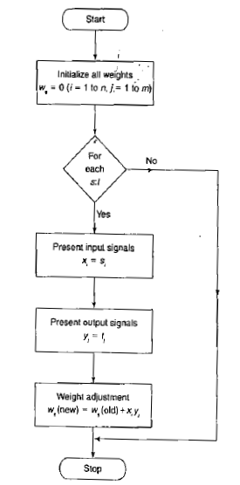
flowchart

Slide 8
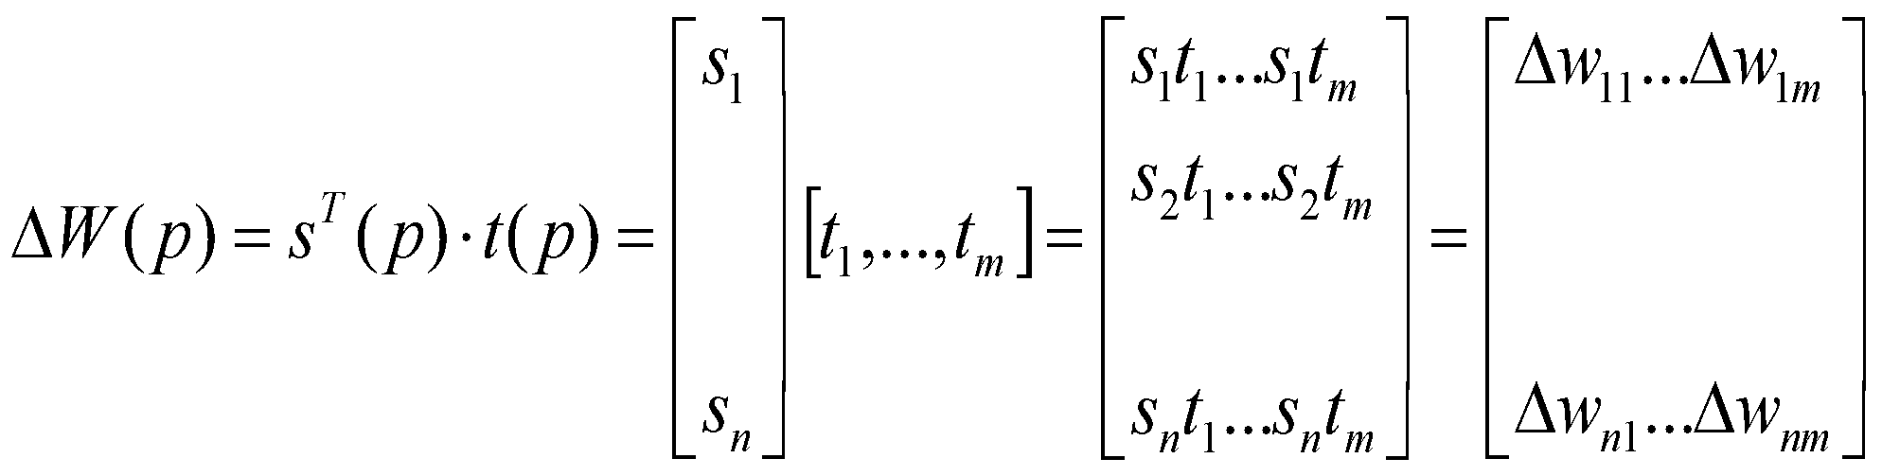
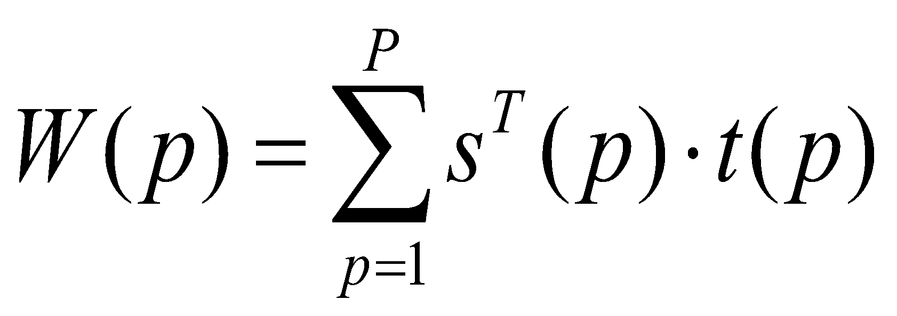
Training algorithm for pattern association-Outer product Rule
Let s and t be row vectors.
Then for a particular training pair s:t
and

Slide 9
Auto-associative Memory Network
In the case of an auto-associative neural net, the training input and the target output vectors are the same.
The determination of weights of the association net is called storing of vectors.
The vectors that have been stored can be retrieved from distorted (noisy) input if the input is sufficiently similar to it.
The net's performance is based on its ability to reproduce a stored pattern from a noisy input.
The weights on the diagonal can be set to zero. This can be called as auto associative net with no self connection.

Slide 10
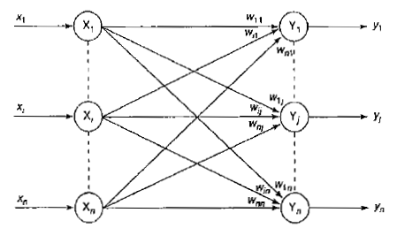
Auto associative memory network Architecture
The input vector has n inputs and output vector has n outputs.
The input and output are connected through weighted connections.

Slide 11

Training Algorithm
Initialize weights to 0
w_{ij}=0 (i= 1 to n, j=1 to n)
For each of the vector that has to be stored
Activate the input layers for training input.
x_{i}=s_{i}(for i=1 to n)
Activate the output layers for target output.
y_{i}=s_{i}(for j=1 to n)
Adjust weight .
w_{ij}(new)=w_{ij}(old)+x _{i}y_{j}
Weight can also be found by

Slide 12


Testing Algorithm
An auto associative network can be used to determine whether the given vector is a ‘known’ or ‘unknown vector’.
A net is said to recognize a “known” vector if the net produces a pattern of activation on the output which is same as one stored.
Testing procedure is as follows:
Step 0: Set weights obtained from Hebb’s rule
Step 1: For each testing input vector perform steps 2 to 4
Step 2: Activation of inputs is equal to input vector.
Step 3: calculate the net input for each output unit j=1 to n:
Step 4: Calculate the output by applying the activation vector over the net input

Slide 13
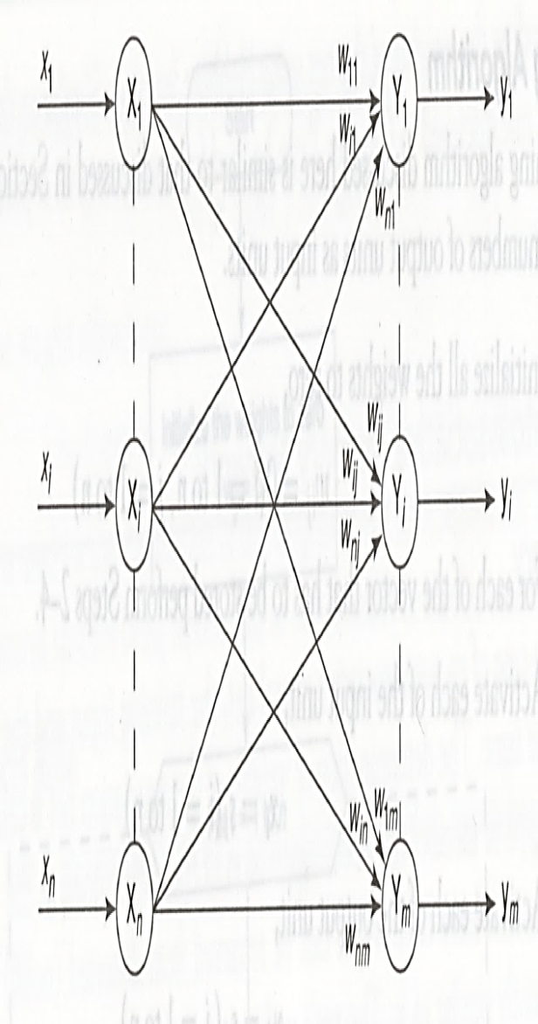
Hetero associative memory network

Slide 14

Hetero associative memory network
The training input and target output vectors are different.
Input has ‘n’ units and output has ‘m’ units and there is a weighted interconnection between input and output.
Testing Algorithm
Initialize the weights from the training algorithm.
for each input vector presented.
Set the activation inputs equal to current input vector
Determine the activation of the output units

Slide 15

Hetero associative memory network
The output vector y is obtained gives the pattern associated with the input vector x.
If the responses are binary then the activation function will be as

Slide 16
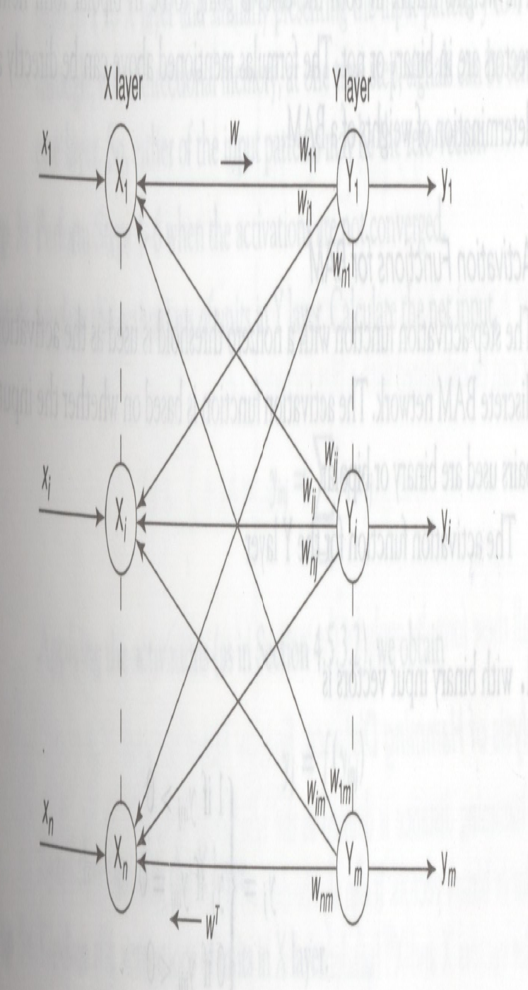
Bidirectional associative memory(BAM)
Weights are bidirectional
X layer has ‘n’ input units
Y layer has ‘m’ output units.
Weight matrix from X to Y is W and from Y to X is W^{T.}

Slide 17
Bidirectional associative memory(BAM)
The BAM was developed by Kosko in the ear 1988.
The BAM network performs forward and backward associative searches for stored responses .
The BAM is a recurrent hetero-associativve pattern-marching network that encodes binary or bipolar patterns using Hebbian learning rule.
It associates patterns, say from set A to patterns from set B and vice versa is also performed.
BAM neural nets can respond to input from either layers ( input layer and output layer).
Two types : Discrete BAM, Continuous BAM

Slide 18


Discrete BAM
Here weight is found to be the sum of outer product of bipolar form.
Activation function is defined with nonzero threshold.
Determination of weights
Input vectors is denoted by s(ρ) and output vector as t(ρ).Then the weight matrix is denoted by
s(ρ)=(S₁ (ρ),...S_{i} (ρ),.,S_{n} (ρ))
Output = t(ρ) = (t₁ (ρ),...t_{j} (ρ),.,t_{m} (ρ))
Weight matrix is determined using the Hebb Rule.
If the input vectors is binary, then weight matrix
W={w_{ij}}=
If the input vectors are bipolar, the weight matrix
W={w_{ij}}=

Slide 19




Activation Function for BAM
The Activation Function is based on whether the input target vector pairs used are binary or bipolar.
The Activation function for Y layer with binary input vectors is
with bipolar input vector is
The activation function for the X layer with binary input vector is
With bipolar input vector is
If threshold value is equal to the net input, then the previous output value is calculated is left as the activation of that unit. Signals are sent only from one layer to the other and not in both directions.

Slide 20

Testing algorithm for discrete BAM
Test the noisy patterns entering into the network.
Testing algorithm for the net is as follows:
Step 0: Initialize the weights to store ρ vectors. Also initialize all the activations to zero.
Step 1:Perform steps 2-6 for each testing input.
Step 2: Set the Activation of X layer to current input patterns, presenting the input x to X layer and presenting the input pattern y to Y layer. It is bidirectional memory.
Step 3: Perform steps 4-6 when the activations are not converged.
Step 4: Update the activation of units in Y layer. Calculate the net input.

Slide 21

Applying the Activation, we get yj=f(yinj).
Send this signal to X layer.
Step 5: Update the activation of units in X layer.
Calculate the net input
Applying the activation over the net input
xi=f(xini)
Send this signal to Y layer.
Step 6: Test for convergence of the net. The convergence occurs if the activation vectors x and y reach equilibrium. If this occurs, then stop, else continue.

Slide 22



Continuous BAM
It uses logistic Sigmoid function as the activation functions for all units.
It may be binary sigmoid or bipolar sigmoid.
Bipolar sigmoid function with high gain, converge to vector state and acts like DBAM.
If the input vectors are binary, s(ρ), t(ρ), the weights are determined using the formula
w_{ij}=
If a binary logistic function is used, then the activation function is
If the activation function is bipolar logistic function then,
Net input calculated with bias is included

Slide 23
Analysis of hamming distance, energy function and storage capacity
The hamming distance is defined as the number of mismatched components of two given bipolar or binary vectors.
It is denoted as H[x , x’].
The average hamming distance between the vectors is (1/n)H[x , x’], where ‘n’ is the number of components in each vector.
Consider the vectors, x = [1 0 1 0 1 1 0], x’ = [1 1 1 1 0 0 1]
Hamming distance between these two given vectors is equal to 5. the average hamming distance is 5/7

Slide 24
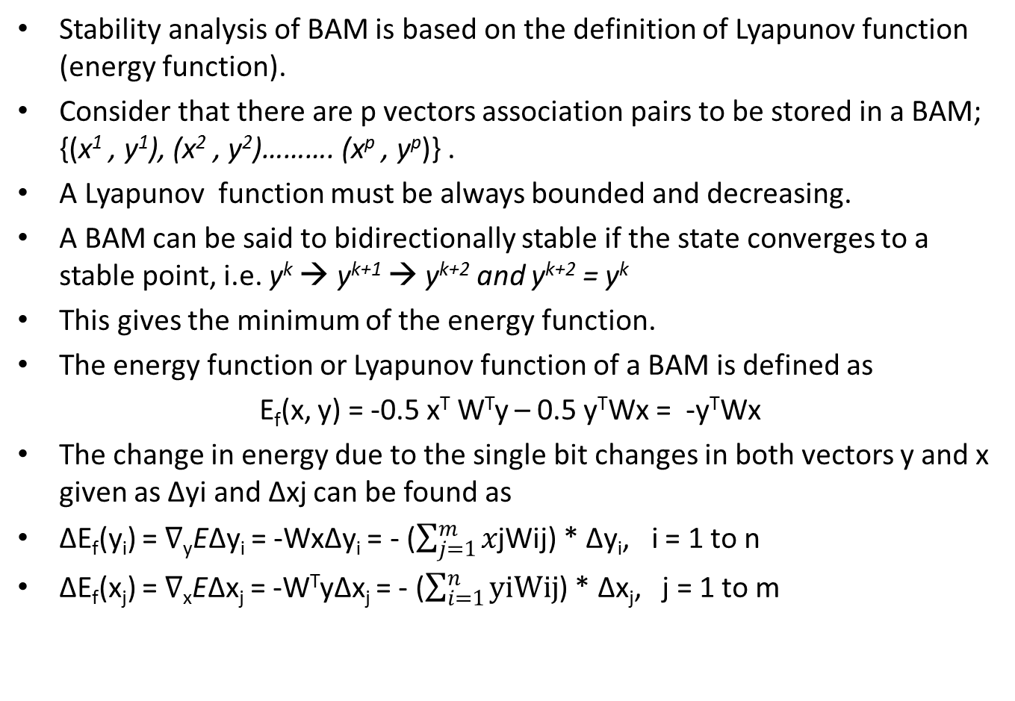

Slide 25
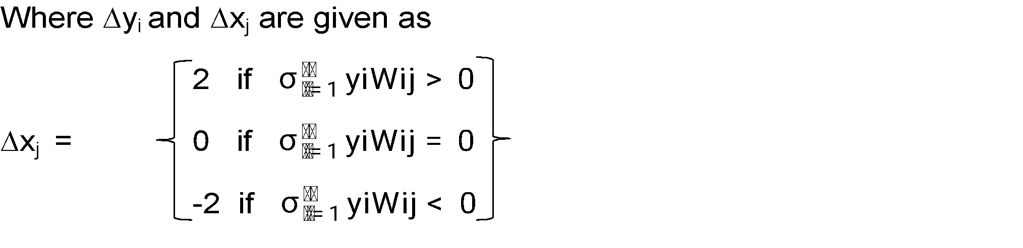
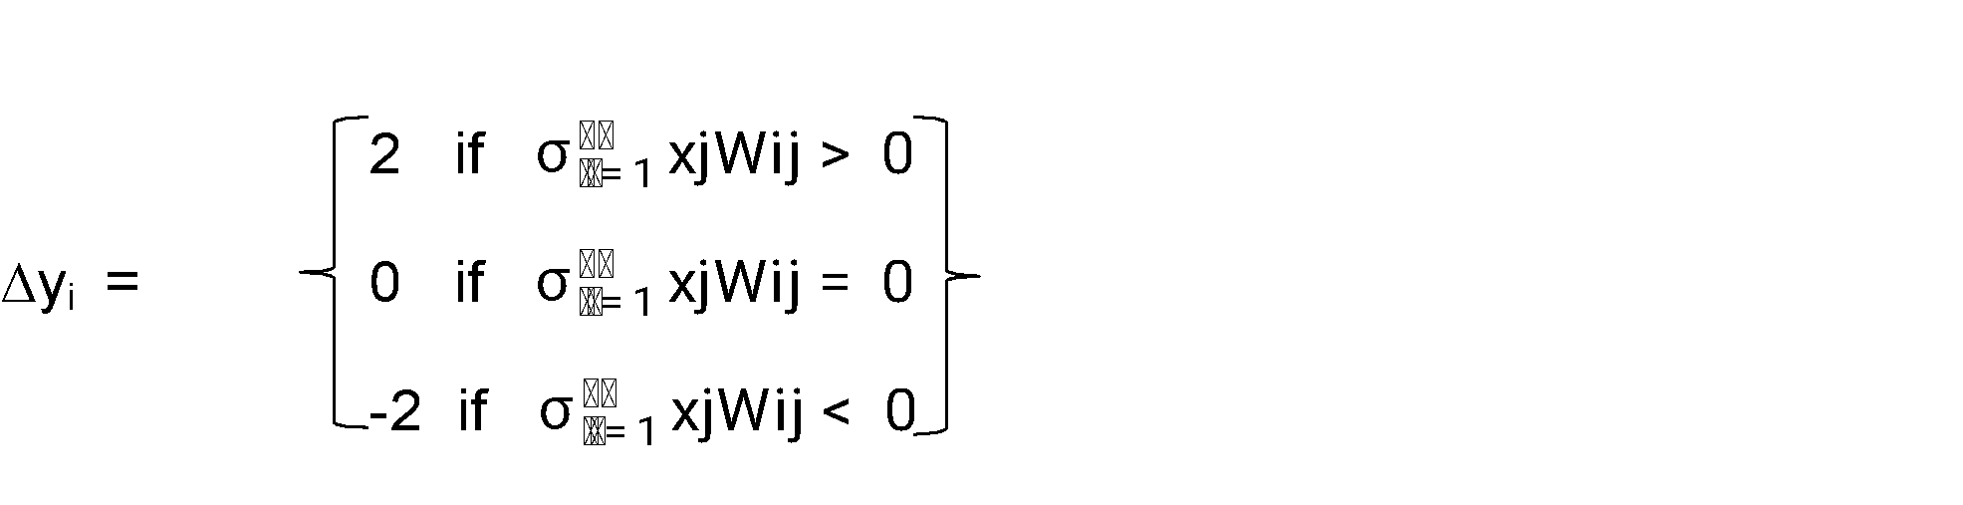
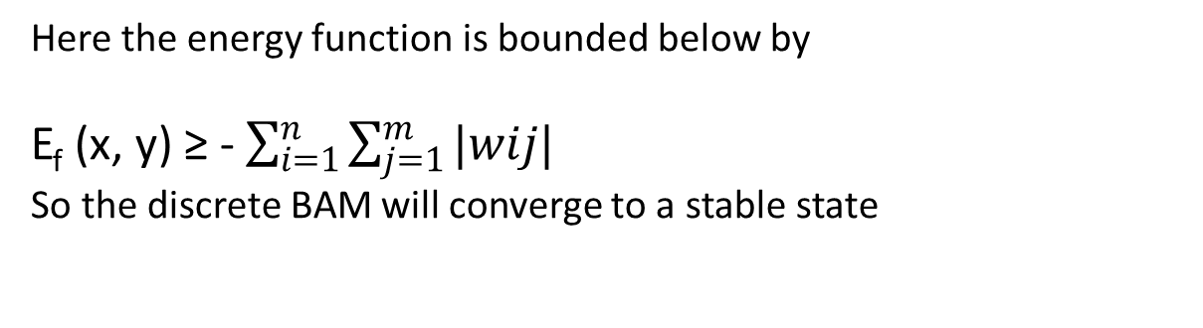

Slide 26
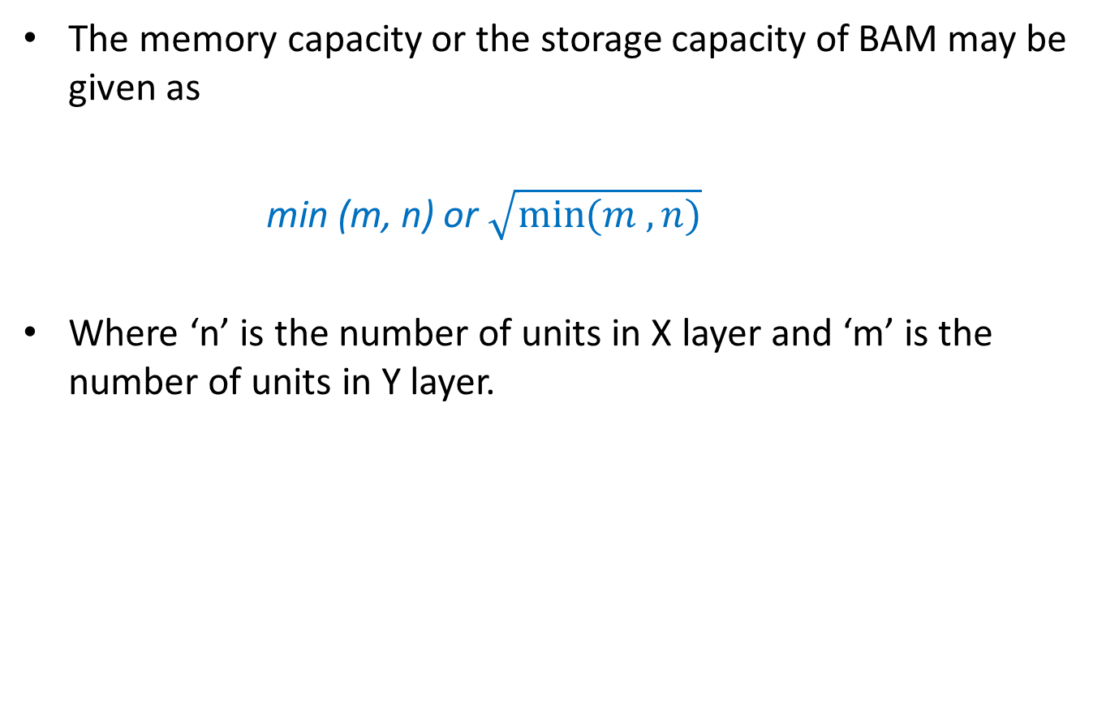

Slide 27
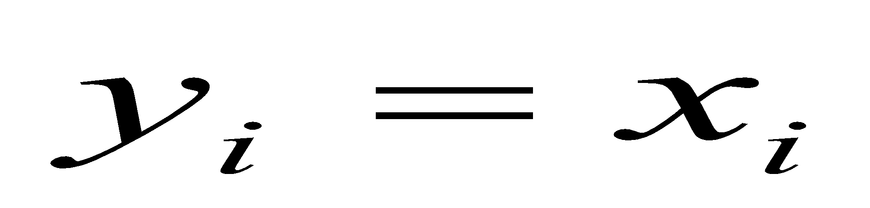
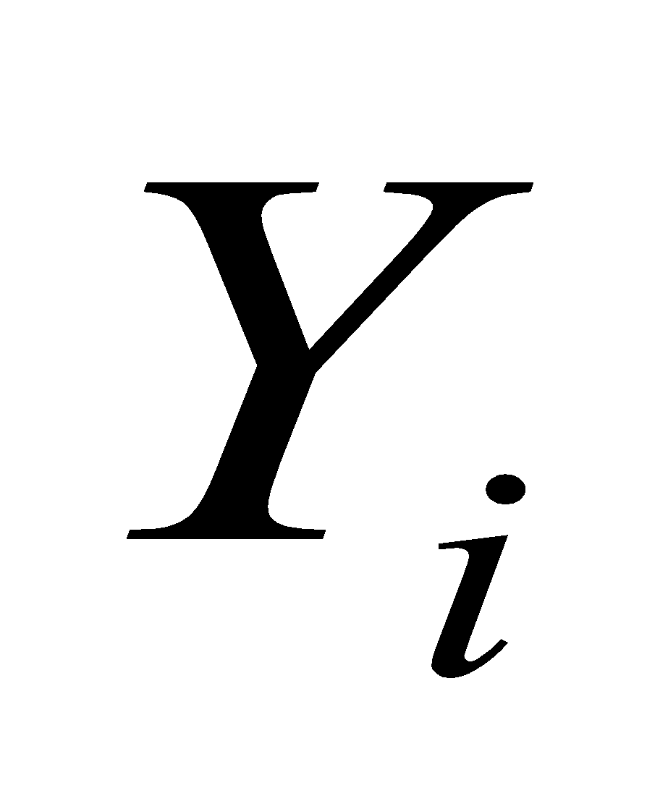
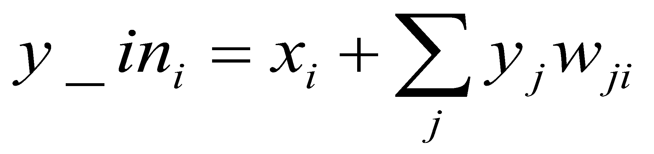
Testing algorithm for Discrete Hopfield Net
Step 0. Initialize weights to store patterns. (Use Hebb rule.)
Step 1.While activations of the net are not converged, do Steps 2-8.
Step 2. For each input vector x, do Steps 3-7.
Step 3. Set initial activations of net equal to the external input vector x:
, ( i=1,2…n)
Step 4. Do Steps 5-7 for each unit
(Units should be updated in random order.)
Step 5. Compute net input:

Slide 28
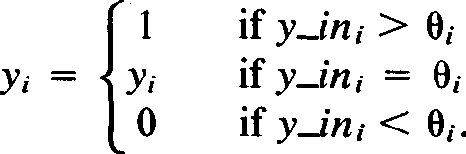
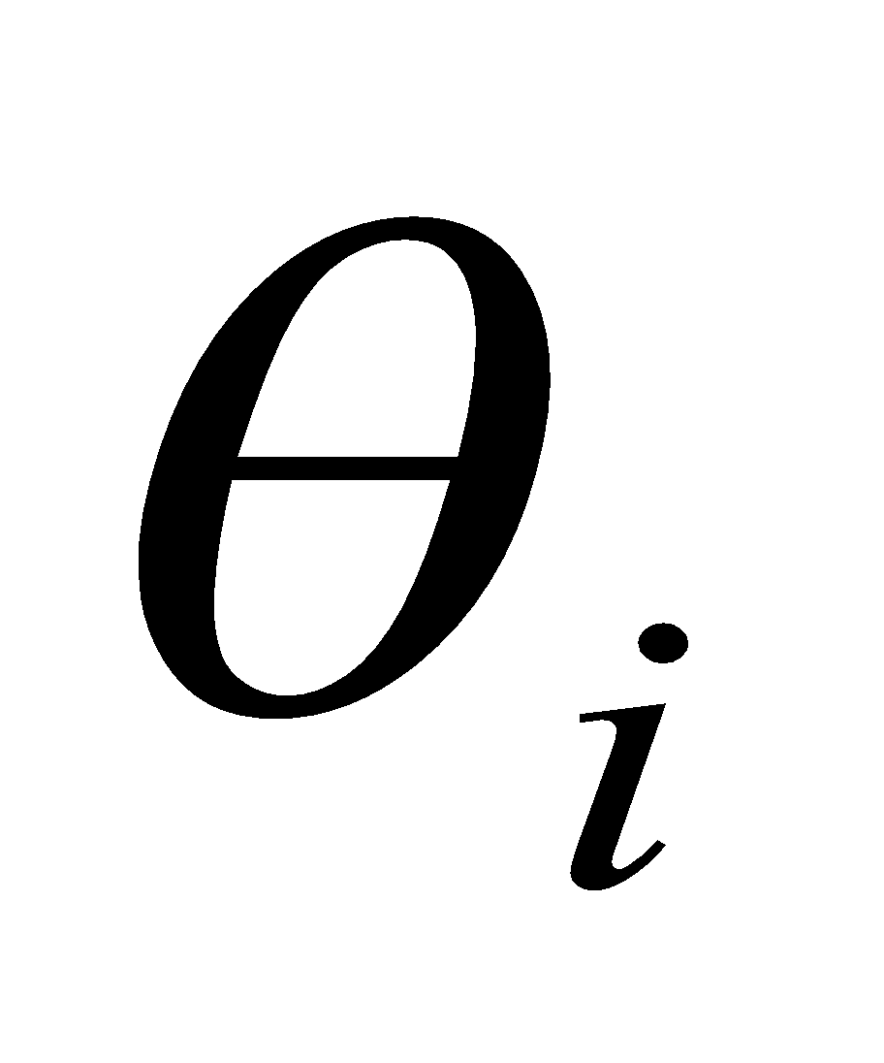
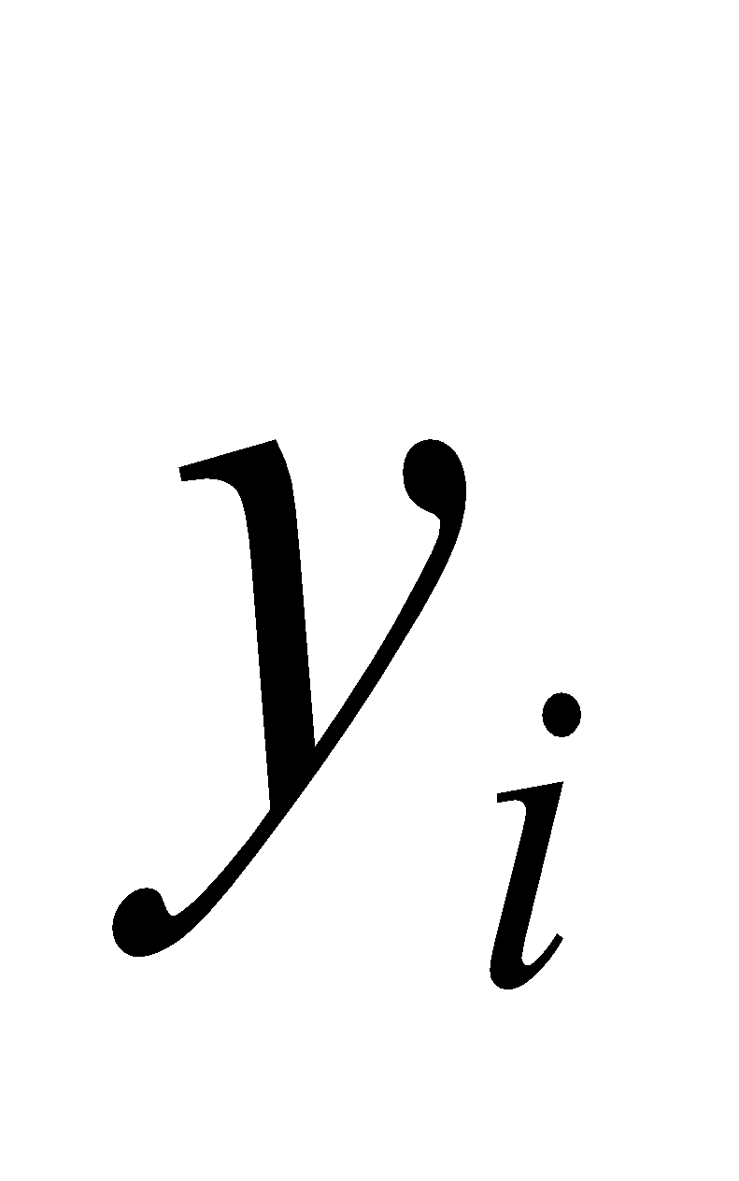
Testing algorithm for Discrete Hopfield Net
Step 6. Determine activation (output signal):
Where is the threshold and is normally chosen as zero.
Step 7. Feed back the obtained output to all other units. This updates the activation vector.)
Step 8. Test for convergence.

Slide 29
Applications
A binary Hopfield net can be used to determine whether an input vector is a "known” or an "unknown" vector.
The net recognizes a "known" vector by producing a pattern of activation on the units of the net that is the same as the vector stored in the net.
If the input vector is an "unknown" vector, the activation vectors produced as the net iterates will converge to an activation vector that is not one of the stored patterns.

Slide 30
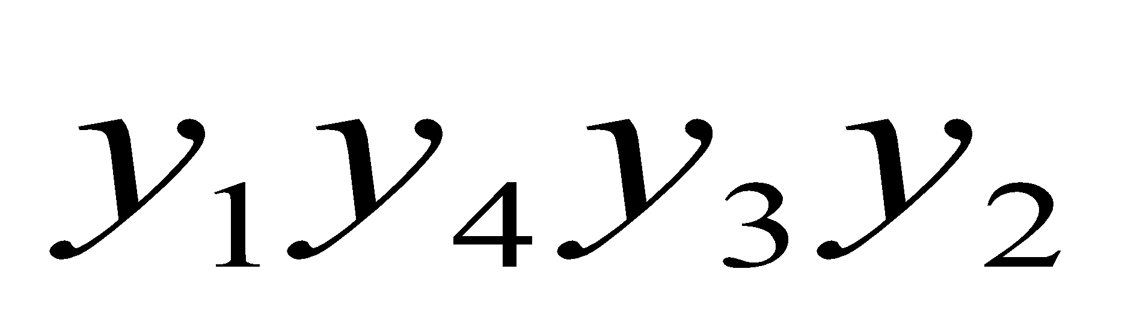
Example:
Consider an Example in which the vector (1, 1, 1,0) (or its bipolar equivalent (1, 1, 1, - 1)) was stored in a net. The binary input vector corresponding to the input vector used (with mistakes in the first and second components) is (0, 0, 1, 0). Although the Hopfield net uses binary vectors, the weight matrix is bipolar. The units update their activations in a random order. For this example the update order is

Slide 31
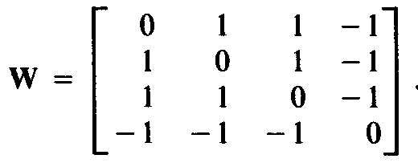
W = ∑ s^{T}(p)t(p) = [1 1 1 -1]
W =
The weight matrix with no self connection is:
1
1
1
-1
1 1 1 -1
1 1 1 -1
1 1 1 -1
-1 -1 -1 1

Slide 32
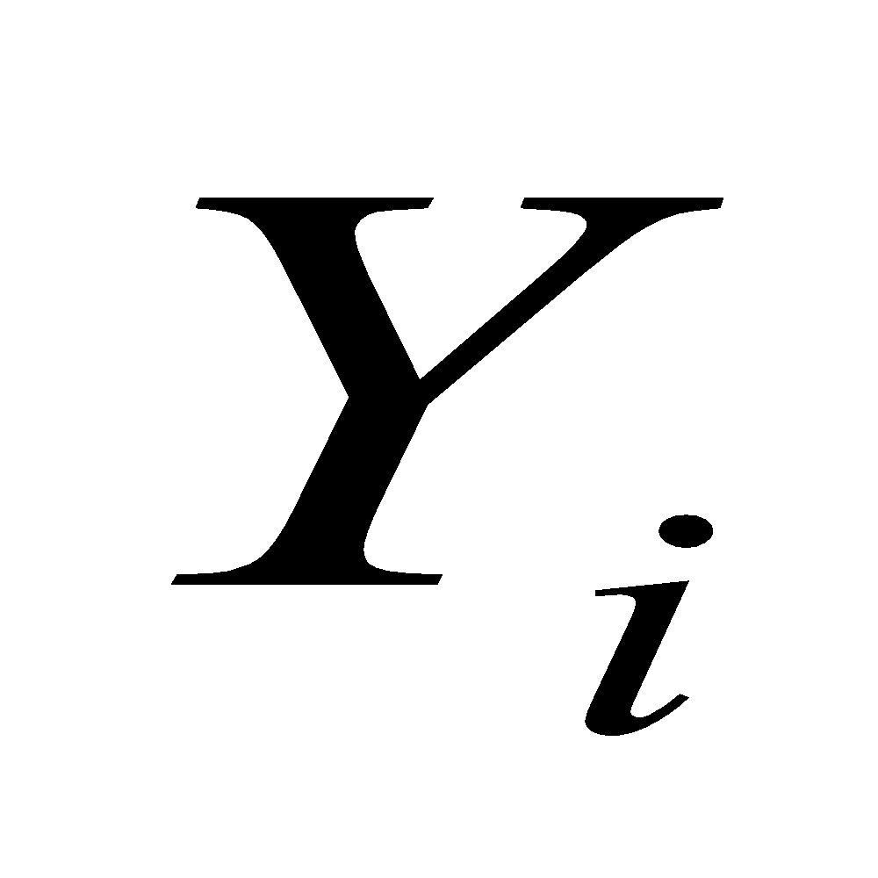

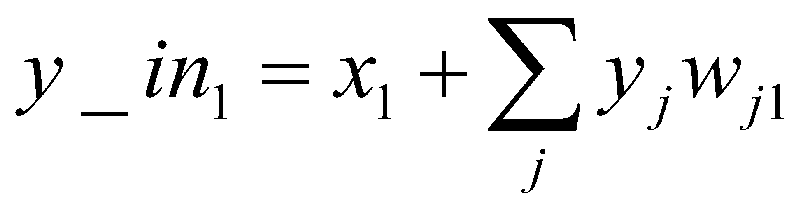
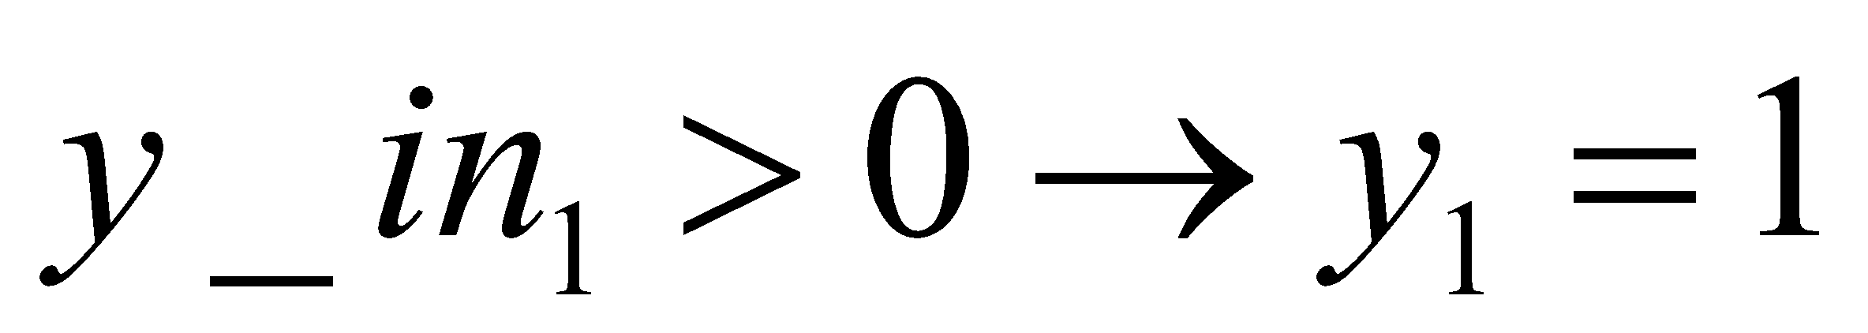
Step 0. Initialize weights to store patterns:
Step 1. The input vector is x = [0, 0, 1, 0].
Step 2. for this vector y = [0, 0, 1, 0].
Step 3. Choose unit to update its activation:
step 4.
= 0+[0 0 1 0] = 0+1 =1
step 5.
step 6. y=(1,0,1,0) No Convergence
0
1
1
-1

Slide 33
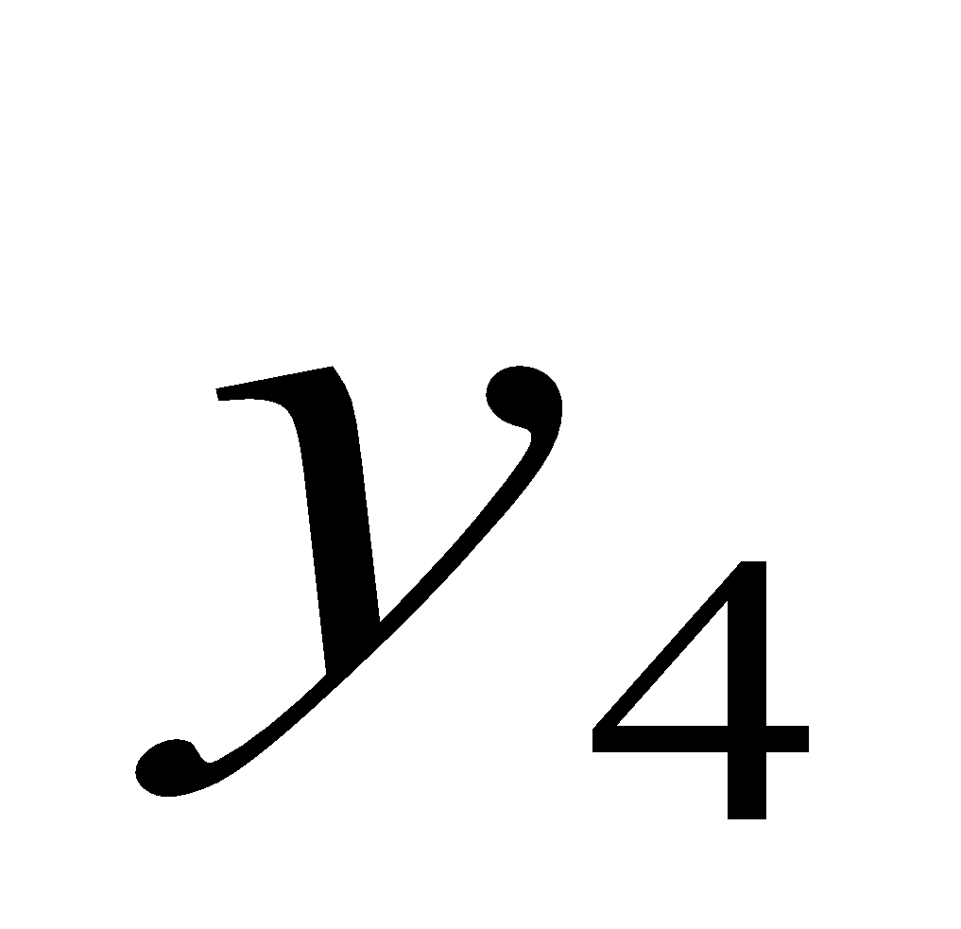
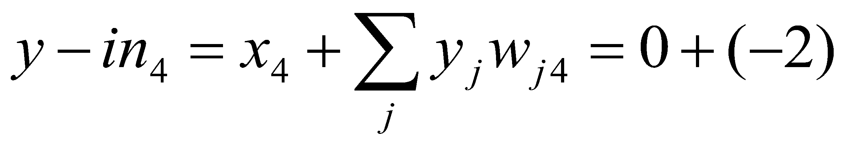
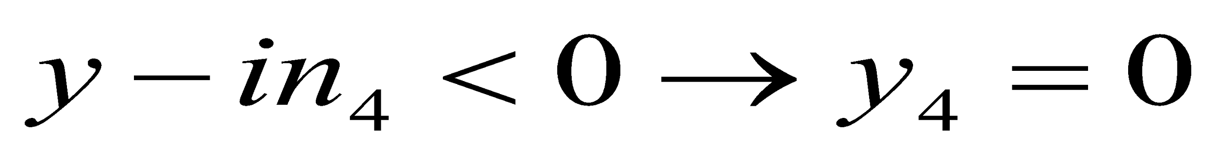
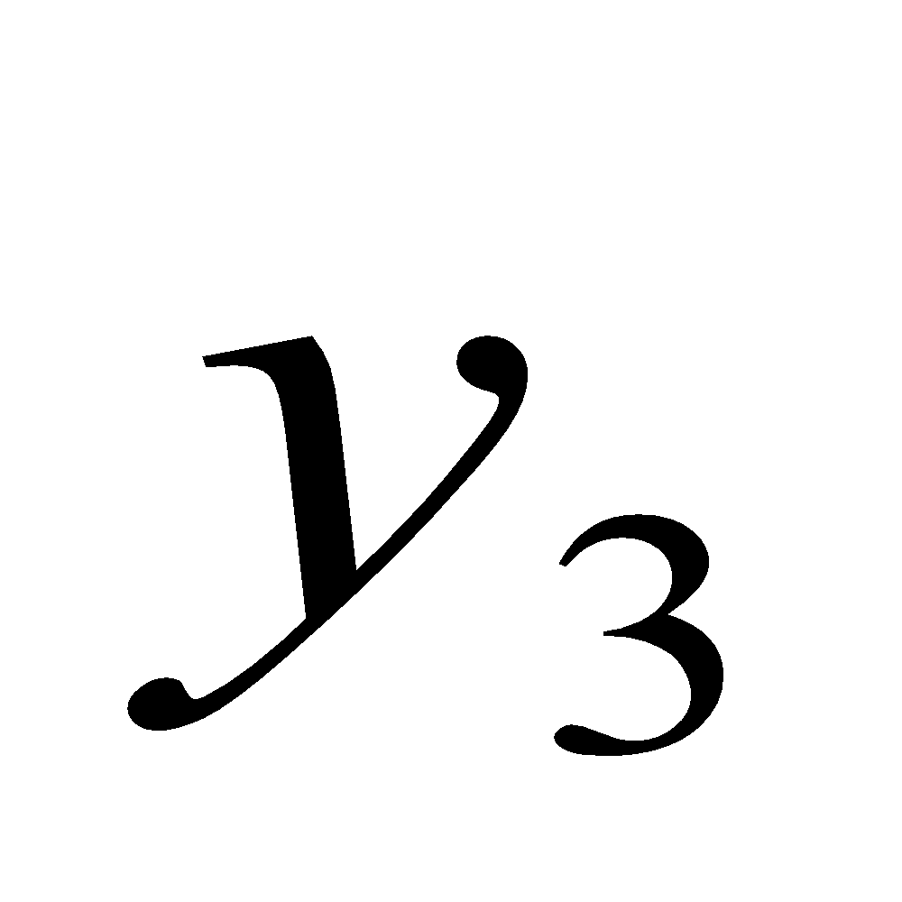
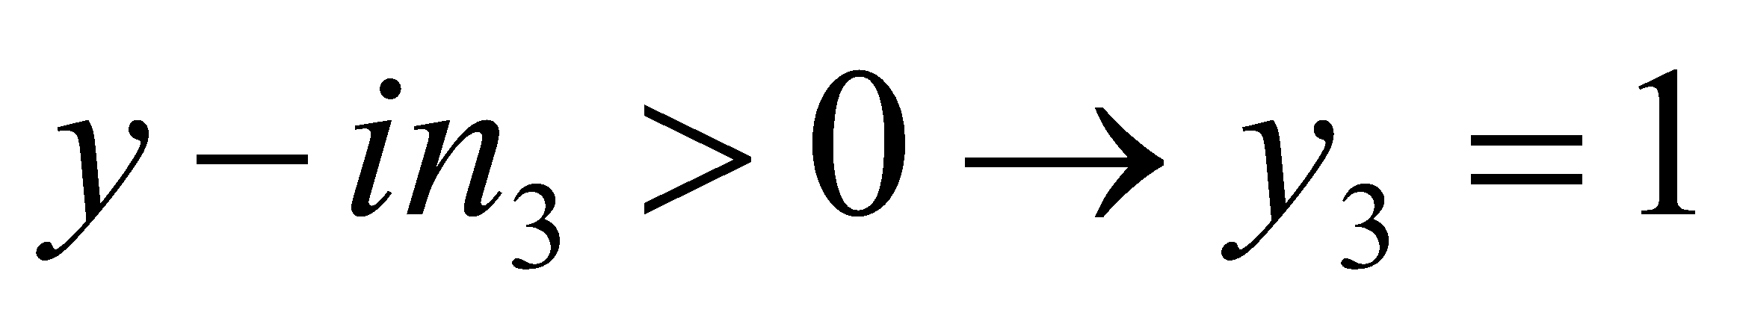
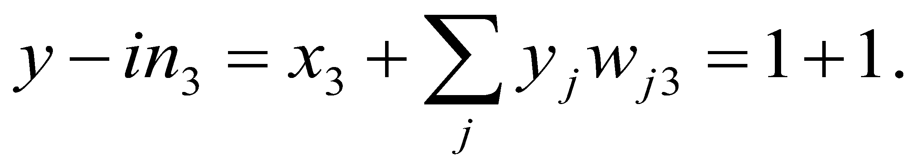
Step 3. Choose unit to update its activation:
step 4.
step 5.
step 6. y=(1,0,1,0). No Convergence
step 3. Choose unit to update its activation:
step 4.
step 5.
Step 6. y=(1,0,1,0). No Convergence

Slide 34
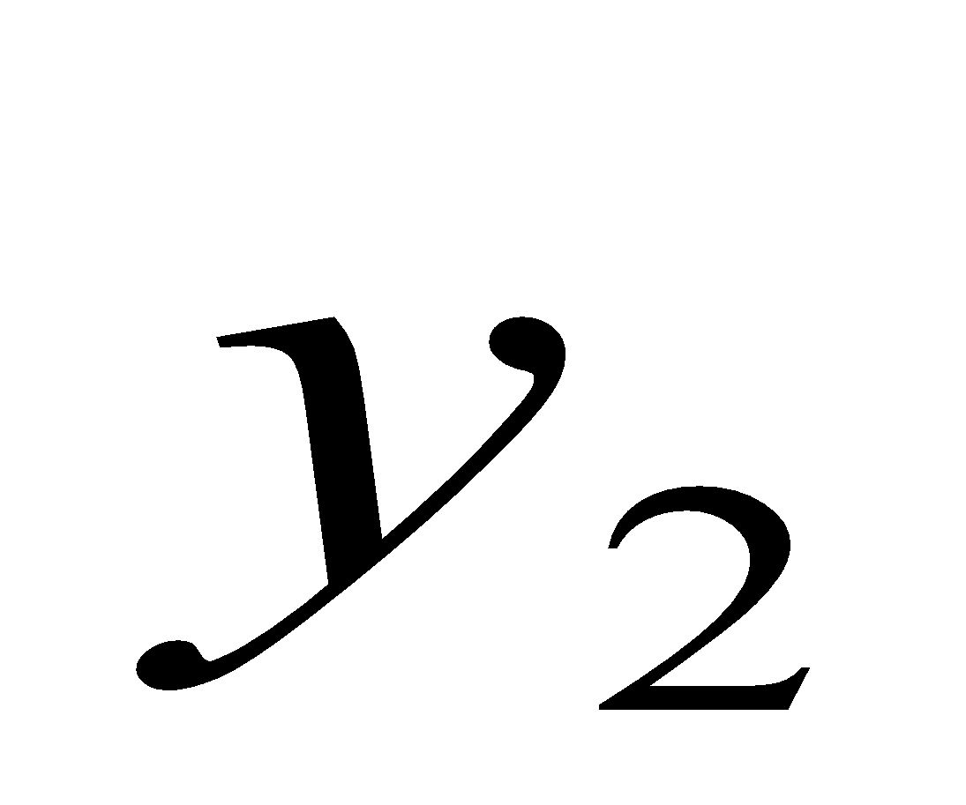
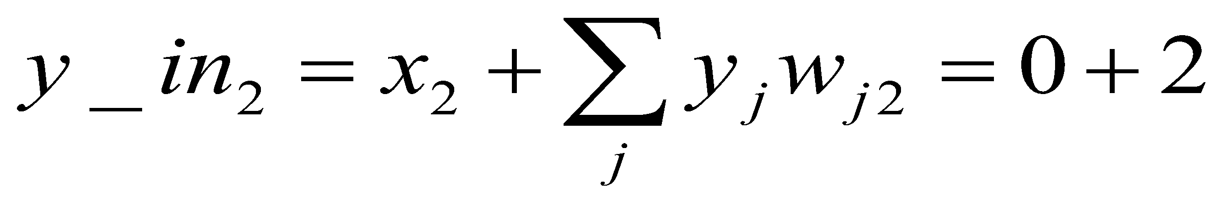
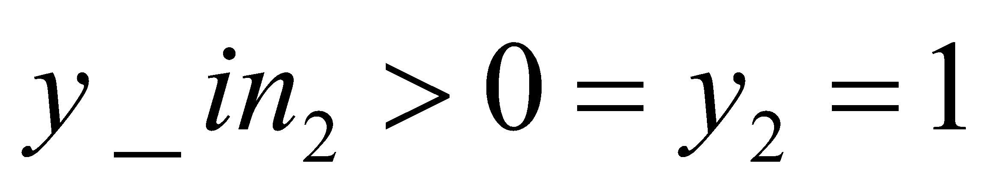
step 3. Choose unit to update its activation:
step 4.
step 5.
step 6. y=(1,1,1,0) Converges with vector x.
Step 7. Test for convergence: thus the output y has converged with vector x in this iteration itself. But, one more iteration can be done to check whether further activations are there or not.
Weight matrix w will be same and input vector x = [1 1 1 0].
For same sequence of updation of weights. i.e. y1, y4, y3, y2

Slide 35
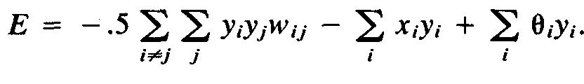
Analysis
Energy Function.
An energy function is a function that is bounded below and is a non increasing function of the state of the system.
For a neural net, the state of the system is the vector of activations of the units.
Thus, if an energy function can be found for an iterative neural net, the net will converge to a stable set of activations.
Energy function for the discrete Hopfield net is given by,

Slide 36
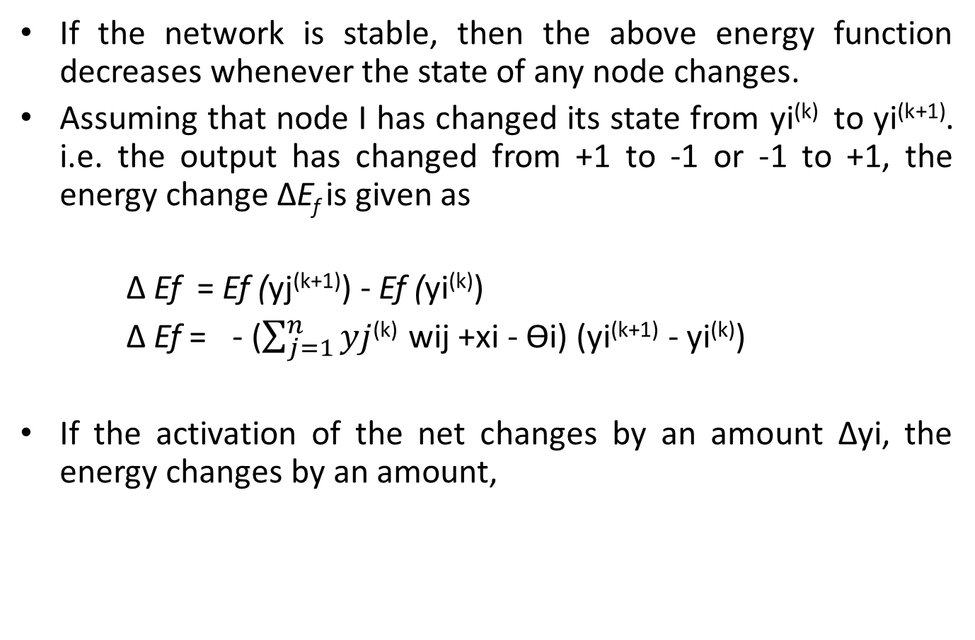
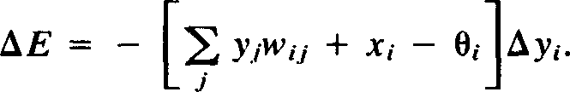

Slide 37
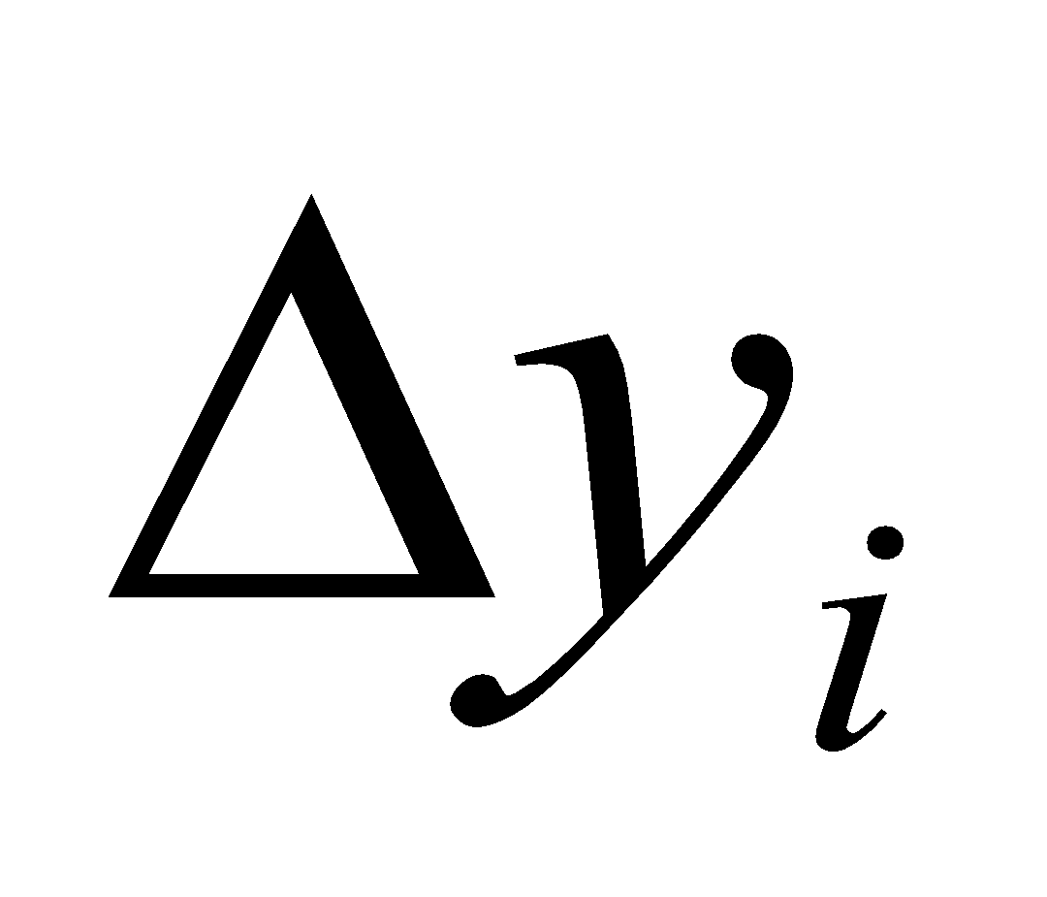
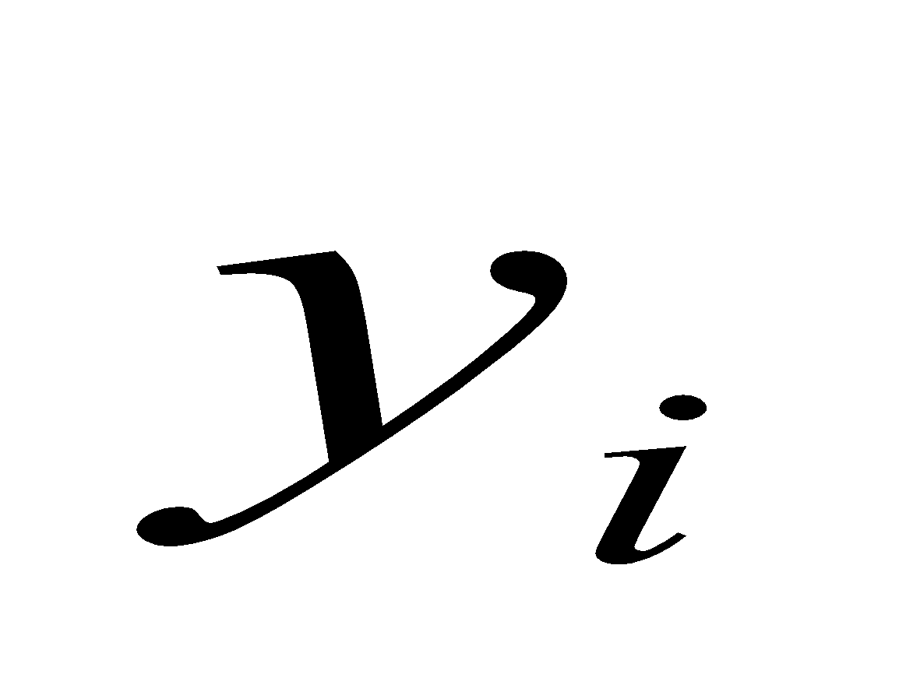
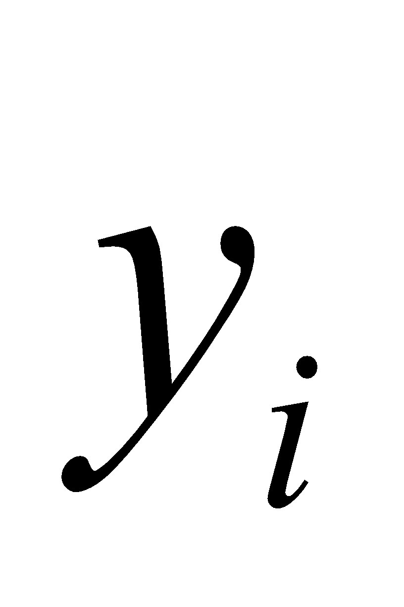
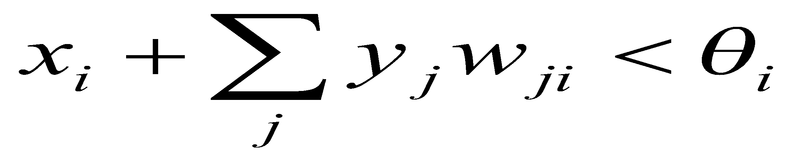
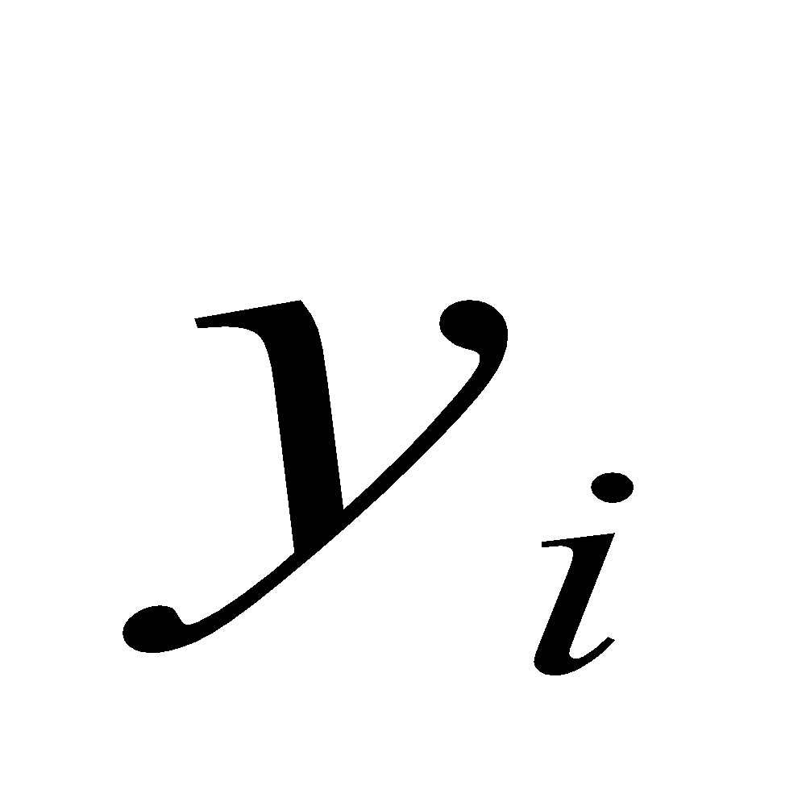
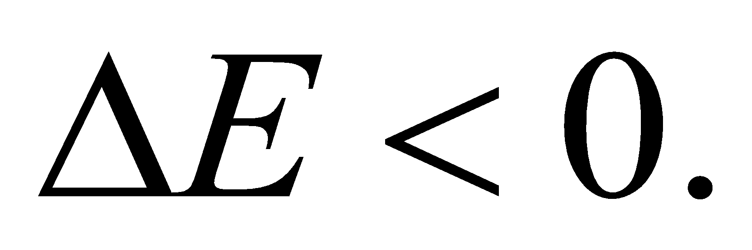
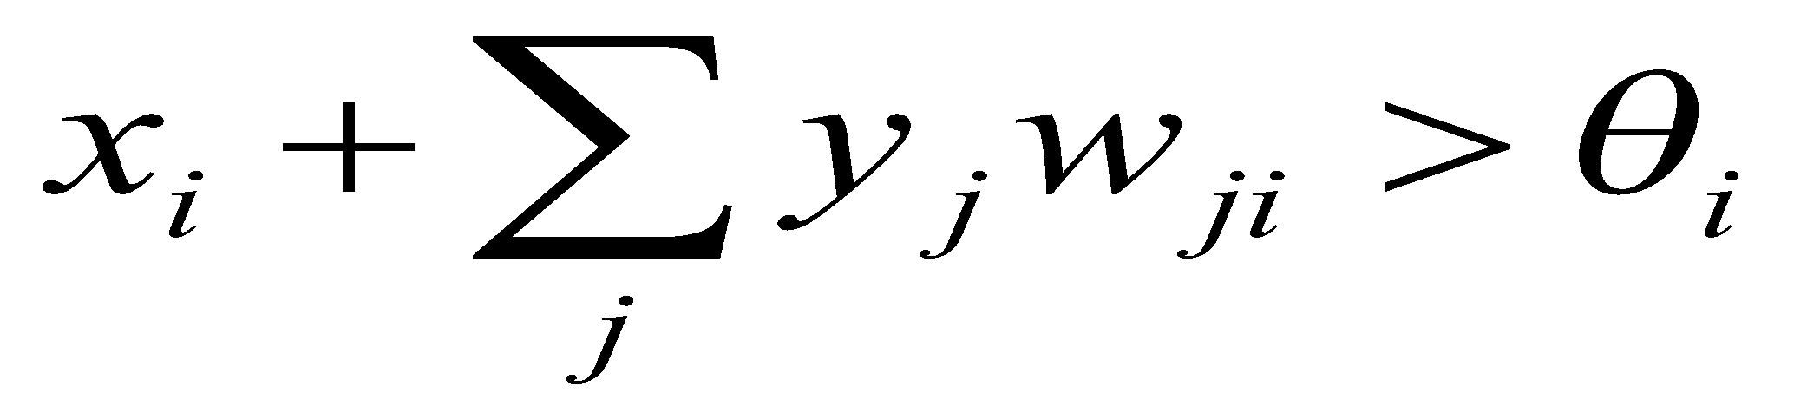
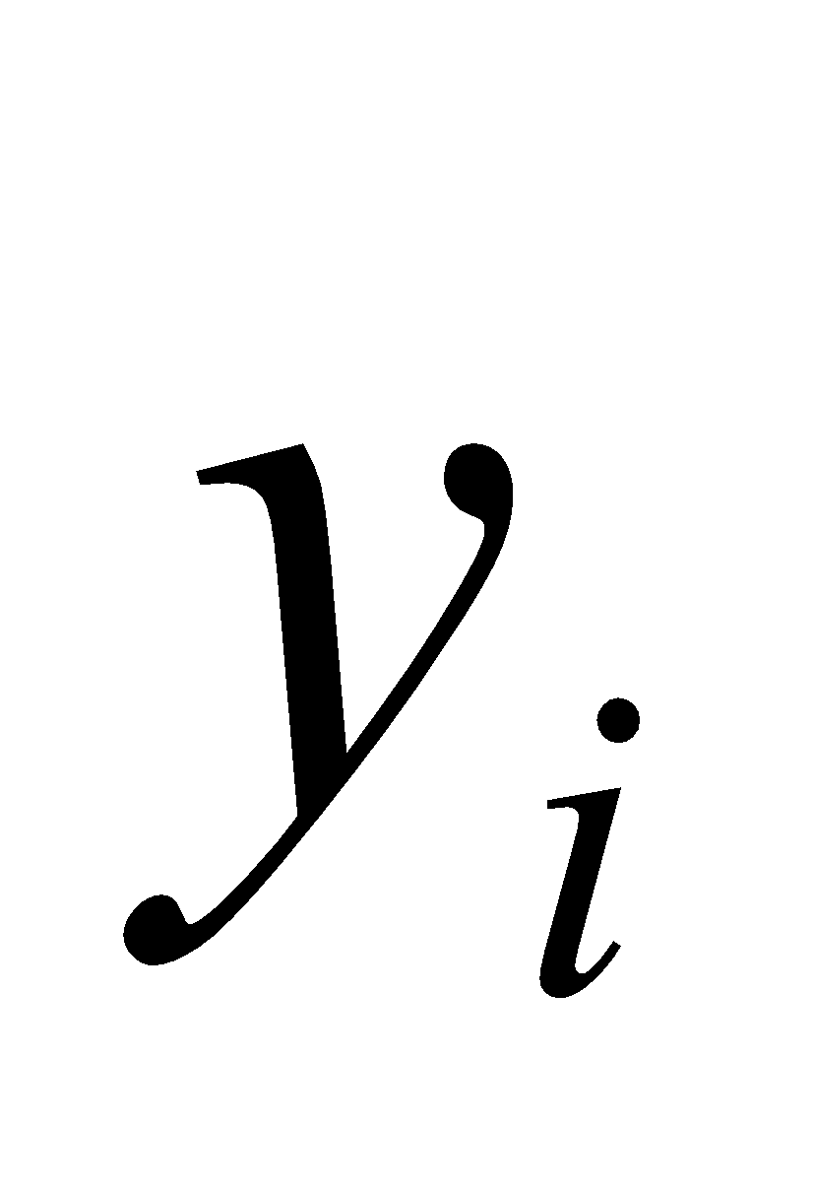
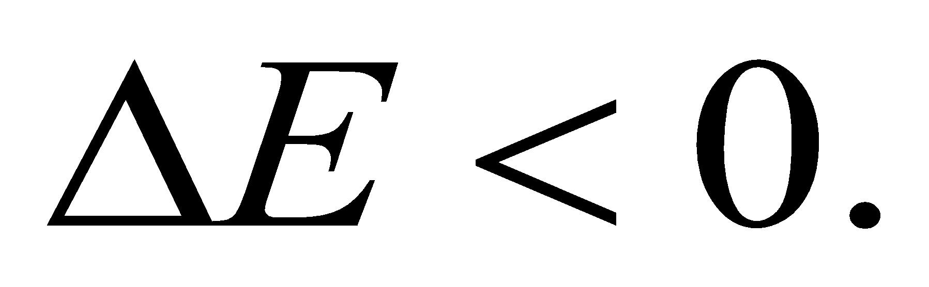
consider the two cases in which a change will occur in the activation of neuron
If is positive, it will change to zero if,
This gives a negative change for In this case,
If is zero, it will change to positive if,
This gives a positive change for In this case,

Slide 38
Hence ∆yi is positive only if net input is positive and ∆yi is negative only if net input is negative.
Therefore energy cannot increase in any manner.
As a result, because energy is bounded, the net must reach a stable state equilibrium, such that the energy does not change with further iteration.
From this it can be concluded that the energy change depends mainly on the change in activation of one unit and on the symmetry of weight matrix with zeros existing on the diagonal.

Slide 39

Storage Capacity.
Hopfield found experimentally that the number of binary patterns that can be stored and recalled in a net with reasonable accuracy, is given approximately by,
n = The number of neurons in the net.

Slide 40
UNSUPERVISED LEARNING
No help from the outside.
No training data, no information available on the desired output.
Learning by doing.
Used to pick out structure in the input:
Clustering,
Reduction of dimensionality 🡪 compression.
Example: Kohonen’s Learning Law.

Slide 41
FEW UNSUPERVISED LEARNING NETWORKS
There exists several networks under this category, such as
Max Net,
Mexican Hat,
Kohonen Self-organizing Feature Maps,
Learning Vector Quantization,
Counterpropagation Networks,
Hamming Network,
Adaptive Resonance Theory.

Slide 42
COMPETITIVE LEARNING
Output units compete, so that eventually only one neuron (the one with the most input) is active in response to each output pattern.
The total weight from the input layer to each output neuron is limited. If some connections are strengthened, others must be weakened.
A consequence is that the winner is the output neuron whose weights best match the activation pattern.

Slide 43
SELF-ORGANIZATION
Network Organization is fundamental to the brain
Functional structure.
Layered structure.
Both parallel processing organization of the brain.
and serial processing require

Slide 44
SELF-ORGANIZING FEATURE MAP
Our brain is dominated by the cerebral cortex, a very complex structure of billions of neurons and hundreds of billions of synapses. The cortex includes areas that are responsible for different human activities (motor, visual, auditory, etc.) and associated with different sensory inputs. One can say that each sensory input is mapped into a corresponding area of the cerebral cortex. The cortex is a self- organizing computational map in the human brain.

Slide 45
SELF-ORGANIZING NETWORKS
Discover significant patterns or features in the input data.
Discovery is done without a teacher.
Synaptic weights are changed according to local rules.
The changes affect a neuron’s immediate environment until a final configuration develops.

Slide 46
KOHONEN SELF-ORGANIZING FEATURE MAP (KSOFM)
The Kohonen model provides a topological mapping.
It places a fixed number of input patterns from the input layer into a higher dimensional output or Kohonen layer.
Training in the Kohonen network begins with the winner’s neighborhood of a fairly large size. Then, as training proceeds, the neighborhood size gradually decreases.
Kohonen SOMs result from the synergy of three basic processes
Competition,
Cooperation,
Adaptation.

Slide 47
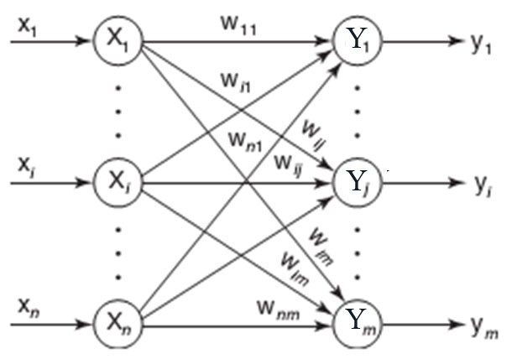
ARCHITECTURE OF KSOFM

Slide 48
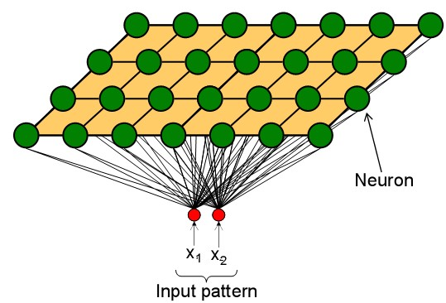
COMPETITION OF KSOFM
Each neuron in an SOM is assigned a weight vector with the same dimensionality N as the input space.
Any given input pattern is compared to the weight vector of each neuron and the closest neuron is declared the winner.
The Euclidean norm is commonly used to measure distance.

Slide 49
CO-OPERATION OF KSOFM
The activation of the winning neuron is spread to neurons in its immediate neighborhood.
This allows topologically close neurons to become sensitive to similar patterns.
The winner’s neighborhood is determined on the lattice topology.
Distance in the lattice is a function of the number of lateral connections to the winner.
The size of the neighborhood is initially large, but shrinks over time.
An initially large neighborhood promotes a topology-preserving mapping.
Smaller neighborhoods allow neurons to specialize in the latter stages of training.

Slide 50
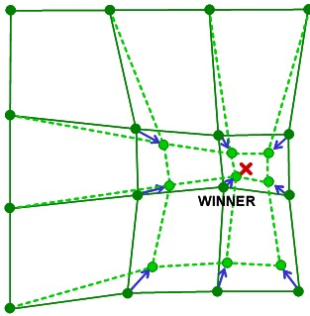
ADAPTATION OF KSOFM
During training, the winner neuron and its topological neighbors are adapted to make their weight vectors more similar to the input pattern that caused the activation.
Neurons that are closer to the winner will adapt more heavily than neurons that are further away.
The magnitude of the adaptation is controlled with a learning rate, which decays over time to ensure convergence of the SOM.

Slide 51
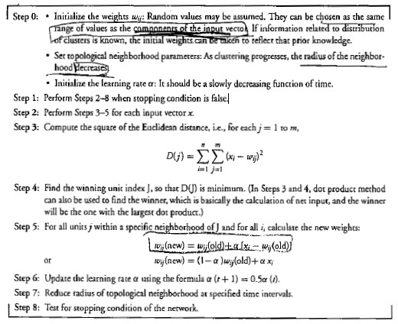

Slide 52
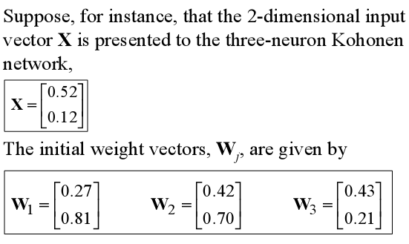
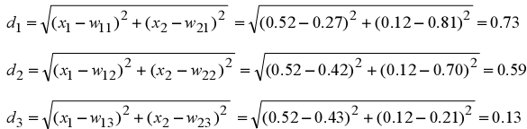
EXAMPLE OF KSOFM
Find the winning neuron using the Euclidean distance:

Slide 53


Neuron 3 is the winner and its weight vector W₃ is updated according to the competitive learning rule:
The updated weight vector W3 at iteration (p+1) is determined as:
The weight vector W3 of the winning neuron 3 becomes closer to the input vector X with each iteration.

Slide 54
ART-Introduction
ART stands for "Adaptive Resonance Theory", invented by Stephen Grossberg in 1976.
ART represents a family of neural networks.
The basic ART System is an unsupervised learning model.
The term "resonance" refers to resonant state of a neural network in which a category prototype vector matches close enough to the current input vector.
ART matching leads to this resonant state, which permits learning. The network learns only in its resonant state.

Slide 55
Key Innovation
The key innovation of ART is the use of “expectations.”
As each input is presented to the network, it is compared with the prototype vector that is most closely matches.
If the match between the prototype and the input vector is NOT adequate, a new prototype is selected. In this way, previous learned memories (prototypes) are not eroded by new learning.

Slide 56
Stability Plasticity Dilemma
Real world is faced with situation where data is continuously changing.
In this situation every learning system faces stability-plasticity dilemma.
Stability: System behaviour doesn’t change after irrelevant events
Plasticity: System adapts its behaviour according to significant events
Dilemma:
How to achieve stability without rigidity and plasticity without chaos?
Ongoing learning capability
Preservation of learned knowledge

Slide 57
The plasticity-stability dilemma poses few questions :
How can we continue to quickly learn new things about the environment and yet not forgetting what we have already learned?
How can a learning system remain plastic (adaptive) in response to significant input yet stable in response to irrelevant input?
How can a neural network can remain plastic enough to learn new patterns and yet be able to maintain the stability of the already learned patterns?

Slide 58
How does the system know to switch between its plastic and stable modes.
ART networks tackle the stability-plasticity dilemma.
The ART network and algorithm maintain the plasticity required to earn new patterns while preventing the modifications of patterns that have been learned previously.
Solves Stability – Plasticity Dilemma.
Forms new memories or incorporates new information based on a predefined vigilance parameter.

Slide 59
ART Network
ART networks consist of an input layer and an output layer.
Bottom-up weights are used to determine output-layer candidates that may best match the current input.
Top-down weights represent the “prototype” for the cluster defined by each output neuron.
A close match between input and prototype is necessary for categorizing the input.
Finding this match can require multiple signal exchanges between the two layers in both directions until
“resonance” is established or a new neuron is added.

Slide 60


Basic ART network Architecture

Slide 61
The basic ART system is unsupervised learning model.
It typically consists of
a comparison field
a recognition field composed of neurons,
a vigilance parameter, and
a reset module

Slide 62
Comparison field:
The comparison field takes an input vector and transfers it to its best match in the recognition field.
Its best match is the single neuron whose set of weights most closely matches the input vector.
Recognition field:
Each recognition field neuron, outputs a negative signal proportional to that neuron's quality of match to the input vector to each of the other recognition field neurons and inhibits their output accordingly.

Slide 63
Vigilance Parameter:
After the input vector is classified, a reset module compares the strength of the recognition match to a vigilance parameter.
The vigilance parameter has considerable influence on the system.
Reset Module:
The reset module compares the strength of the recognition match to the vigilance parameter.
If the vigilance threshold is met, then training commences

Slide 64
ART Algorithm
new pattern
recognition
comparison
categorisation
known
unknown
Adapt winner node
Initialise uncommitted node

Slide 65
Incoming pattern matched with stored cluster templates.
If close enough to stored template joins best matching cluster, weights adapted.
If not, a new cluster is initialised with pattern as template.

Slide 66
ART Types
Unsupervised ARTs
ART1
ART2
ART3
Fuzzy ART
Supervised ARTs
ARTMAP
Fuzzy ARTMAP

Slide 67
ART 1 is the simplest variety of ART networks, accepting only binary inputs.
ART2 extends network capabilities to support continuous inputs.
ART3 is refinement of both modal.
Fuzzy ART implements fuzzy logic into ART’s pattern recognition
ARTMAP also known as Predictive ART, combines two slightly modified ART-1 or ART-2 units into a supervised learning structure .
Fuzzy ARTMAP is merely ARTMAP using fuzzy ART units, resulting in a corresponding increase in efficacy.

Slide 68
ART Operational Phases
Initialization: Before starting all weight vectors B,T and vigilance parameter must be set to initial value.
Recognition: Input vector is applied to initiate recognition phase.
Comparison: At this point, feedback signal from recognition layer cause G1 to go to Zero.
Search : when similarity of wining neuron is greater than vigilance than no search is required otherwise stored pattern must be searched.

Slide 69
Application of ART
Mobile robot control
Facial recognition
Land cover classification
Target recognition
Medical diagnosis
Signature verification

